Slide 1
Look, listen and do The ‘art’ of teaching
Dr jenny wynn

Slide 2
The mediocre teacher tells.
The good teacher explains.
The superior teacher demonstrates.
The great teacher inspires.
William Arthur Ward
(1921-1994)

Slide 3
Fact or fiction?
We are born with all of the neurons that we need and never grow any more
Almost all of the brain’s growth and development occurs before the age of 3 years
After the age of 5 years, neurons start to die
You only use 10% of your brain
Listening to Mozart makes you intelligent

Slide 4
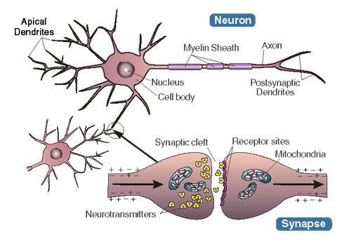
Synapses
Notes:
Bike analogy

Slide 5
Practise makes perfect
Review the basics
Re-learning
Notes:
From conscious to subconscious

Slide 6
The theories
Hemisphere dominance – Harnad, S. (1977)
Experiential learning – Kolb, D. (1980)
VAK or VARK – Flemming, N. (1987)
Multiple intelligences – Gardner, H. (1993)

Slide 7
Male or female brain
Larger in women:
Frontal lobe – decision making
Limbic cortex – regulates emotion
Corpus callosum – membrane joining right and left hemisphere – possibly linked to multi-tasking
Larger in men:
Parietal cortex – spatial perception
Amyygdala – emotional memory
Average intelligence exactly the same!
Notes:
Exaggerated differences in teenage brains

Slide 8
Regions of the brain
Notes:
People with damage to their frontal lobes tend to:
Over-react
Make inappropriate comments
Struggle to plan
Fail to grasp the moral to a story

Slide 9
Left brain vs right brain Harnad, S. (1977)
Left brain
Right brain
Verbal processing
Logical
Sequential
Rational
Analytical
Objective
Looks at parts
Creativity
Random
Intuitive
Holistic
Synthesizing
Subjective
Looks at wholes
Notes:
In 7% population verbal processing in right side of brain
In left-handers, verbal processing in both sides of brain for most
Right hemisphere approximates, left hemisphere calculates so Maths requires both sides of the brain
People with no right hemisphere not devoid of creativity
People with no left hemisphere can be analytical and some can produce language
You are not left or right brain dominant – everyone uses both sides
Lateralized chicks – peck seed from between pebbles and also spot a predator – could not do both and got worse at pecking seeds
The myth can be self-fulfilling

Slide 10
Notes:
Usually cut to treat severe epilepsy

Slide 11
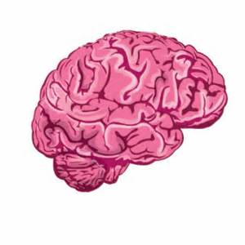
Hemisphere dominance
Take a whole-brain approach:
Anaolgies
Metaphores
Visuals
Role play

Slide 12
Experiential learning Kolb, D. (1980)
Concrete experiment
4
1
Active experimentation
Reflective observation
3
2
Abstract conceptualisation

Slide 13
Learner typologies
Why? Reflectors
What? Theorists
How? Pragmatists
If? Activists

Slide 14
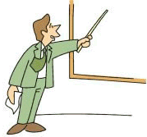
Teaching typologies
Facilitator
Transmitter
Manager
Colleague

Slide 15
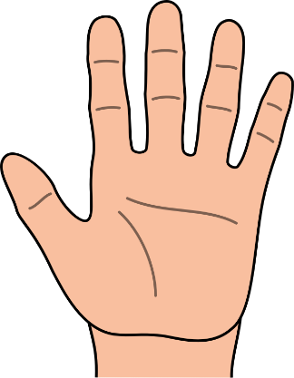
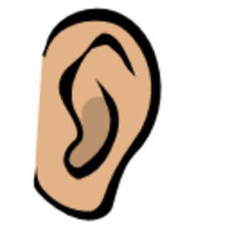
VAK or VARK Flemming N. (1987)
Visual | Auditory
Picture | Listening
Shape | Rhythms
Sculpture | Tone
Paintings | Chants
Kinaesthetic
Making
Touching
Doing
Acting
Reading/writing

Slide 16
Task
Quiz time
Are you V, A or K?

Slide 17
Nationally….
Visual
Auditory
Kinaesthetic
29%
34%
37%

Slide 18
Multiple intelligences Gardener H. (1993)
Verbal – linguistic
Logical – mathematical
Visual – spatial
Bodily – kinaesthetic
Interpersonal
Intrapersonal
Musical
Naturalistic (added in 1999)
Notes:
Douglas Nichols, 2016
Virtual Belfry simulator: “More than one person thought it was easier to ring by listening than by watching. Several said that they were able to see ropesight, or the pattern in the ropes.”

Slide 19
Task
Consider each of Gardener’s intelligences and think of one way you could teach ringing to encourage someone with dominance in that particular intelligence

Slide 20
Bloom’s taxonomy

Slide 21
Remember
Who is?
What is?
When is?
How much?
Give an example of?
Which?

Slide 22
Analyse
Why does?
How does?
Give reasons for
What causes?
What are the similarities/differences?
What is the relationship between?
What are the problems with?
What is the argument for/against?

Slide 23
Synthesize/Create
If…..then….?
What will happen if?
How would things be different if?
If you could….then the result would be….?

Slide 24
Evaluate
Good or bad?
Correct or incorrect?
Effective or ineffective?
Relevant or irrelevant?
Logical or illogical?
Applicable?
Advantages and disadvantages
Pros and cons
Agree or disagree?

Slide 25
Summary
Be observant
Be adaptable
Be flexible
Be different
Be challenging
And enjoy it!

