Slide 1
Revitalising a Band
Making the bells ring out again
‘Cornish experiences’
Brian Wood BA (Hons)

Slide 2
Ringing in Cornwall
Some towers in Cornwall thrive.
Regrettably some don’t!
Cornwall has an active and dedicated ringing community!

Slide 3
The Mission
Get towers ringing again.
Identify the problem.
Teach in the home tower (& why?)
Motivate existing ringers.
Build a new band.
Level 1 model.
Re-energise & move on!

Slide 4
Get Towers Ringing Again
The bells are silent:
Reduced practices or none at all.
Reduced Sunday ringing or none at all.
Struggle for special services need external ringers.

Slide 5
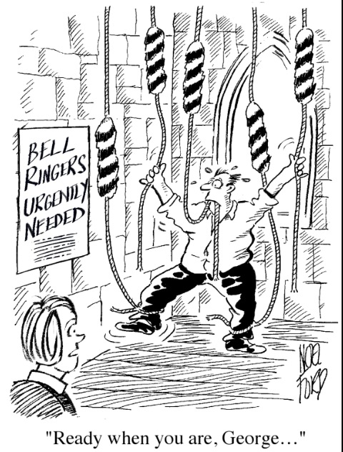

Slide 6
Identify the problem
Not enough learners?
Not enough time to teach learners?
Teaching on normal practise nights?
Low morale/motivation in tower?
Can’t do attitude?
5 min ring sit down for 10?
No band development?
Fixed ways, in a rut?

Slide 7
Problems continued
If you always do
what you always did
you’ll always get
what you always got!
The tower/ band may need external
support and stimulation!

Slide 8
Teaching in the home tower
Not practical to access Diocesan resources.
Need to involve existing ringers.
It’s more than teaching new ringers.
It’s about revitalising the band!

Slide 9
Motivating existing ringers
Some existing ringers can be:
Positive - Receptive & supportive
Positive - Although passive
Negative - Don’t get involved
Negative - Try to undermine

Slide 10
Support
The Church
Bellringers
The Community

Slide 11
Creating ownership
On meeting current ringers I ask for help:
One tower ringer to attend every training session and open tower.
Tower responsible for tying clappers and fitting double muffles and removing for sessions.
Remember: it is their Tower,
their Ringers,
their Band!

Slide 12
The home tower do the course advertising:
Posters
Parish Magazine
Local Press/ Radio
Word of mouth
Poss open day?

Slide 13
Try to involve & inform community:
Incumbent
Local Pub
Shops
Organisations
Create interest!
Promote Ringing

Slide 14
Be lighthearted – ringing is fun!

Slide 15
Level 1 Module (The way I organise the course)
Induction session.
Tied bell - 1 to 1 aim for at least 30 min rope time per session. I start with 3 sessions a week.
Follow ‘Learning the ropes Level 1’

Slide 16
Beyond level 1
Introduce leading exercises
Prepare for change ringing
Consider using Mexican Wave
Experience other towers
Group cohesion and dynamics
The new tower band – The Team
Hand over / exit strategy
Problems Challenges! - lessons

Slide 18
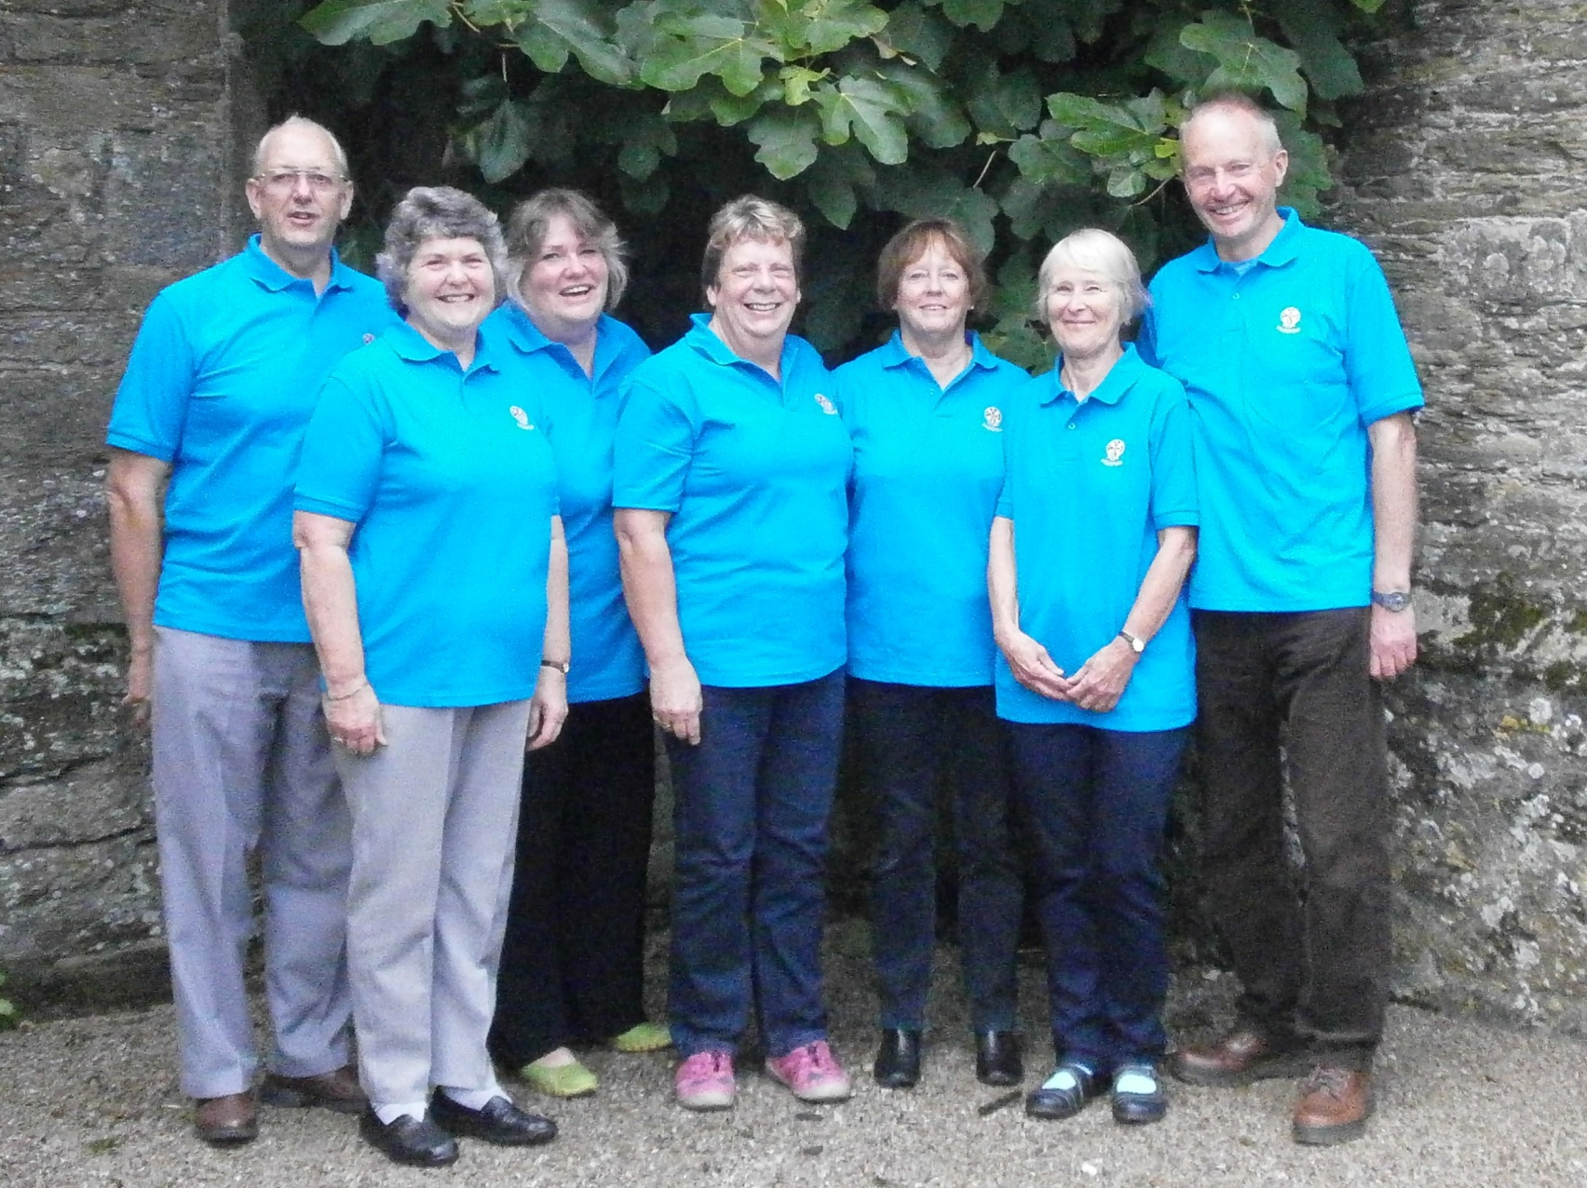
Team Padstow

Slide 19
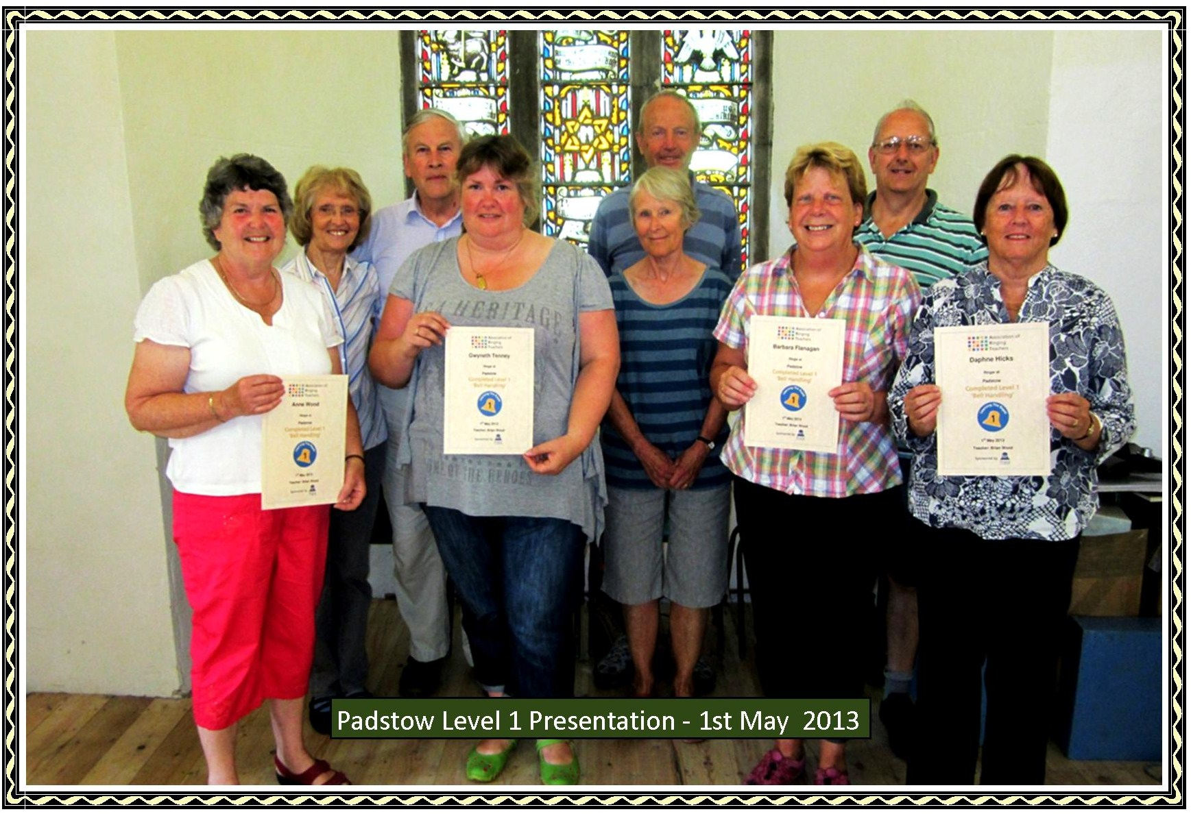
1

Slide 20
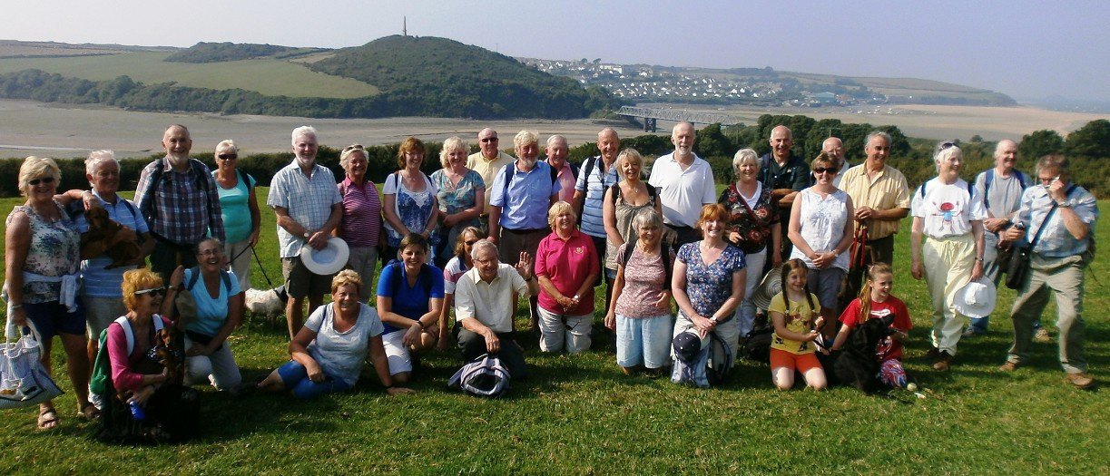
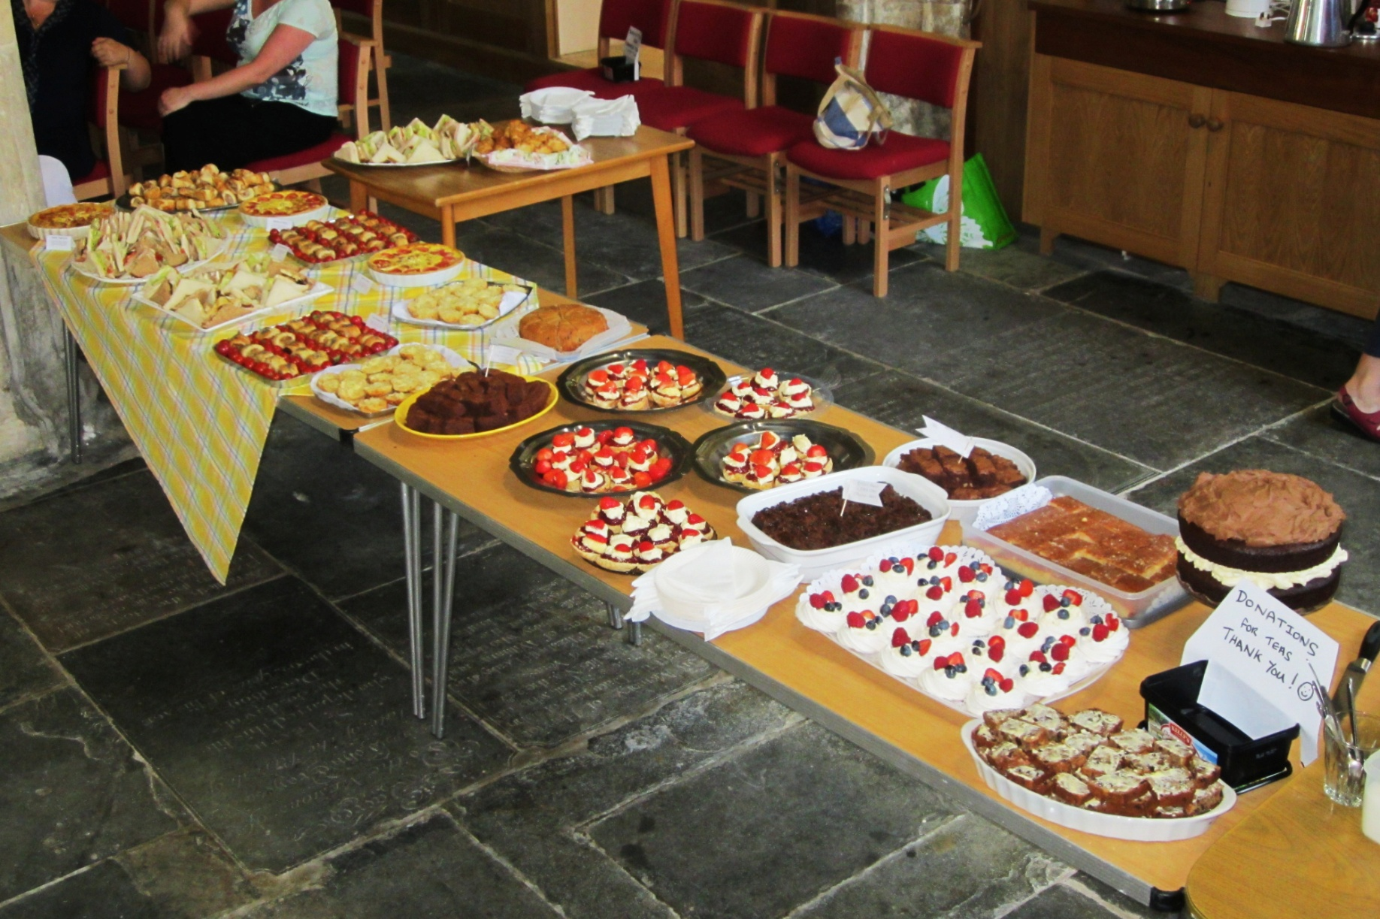
Hosting Ringing Events

Slide 21
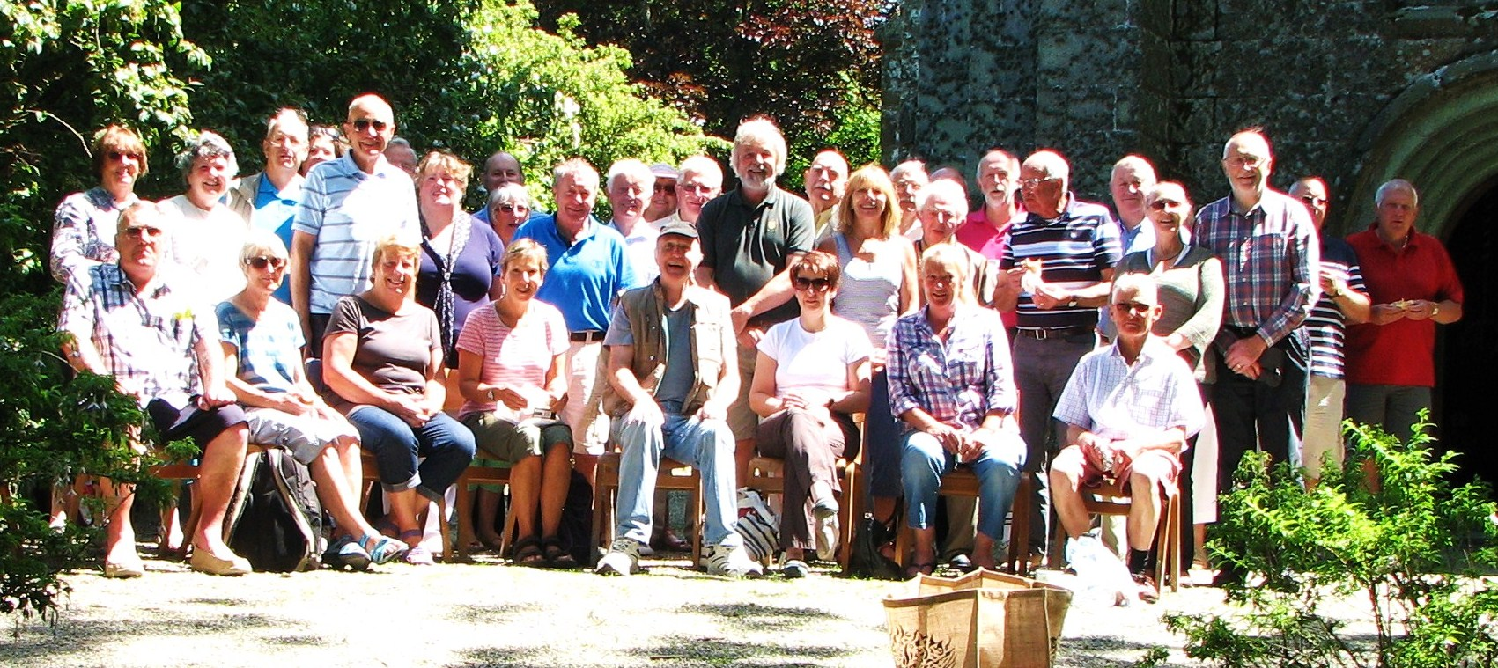
Ring & Picnic St Erme
Ringing is fun! Socialise with the wider ringing community

Slide 22
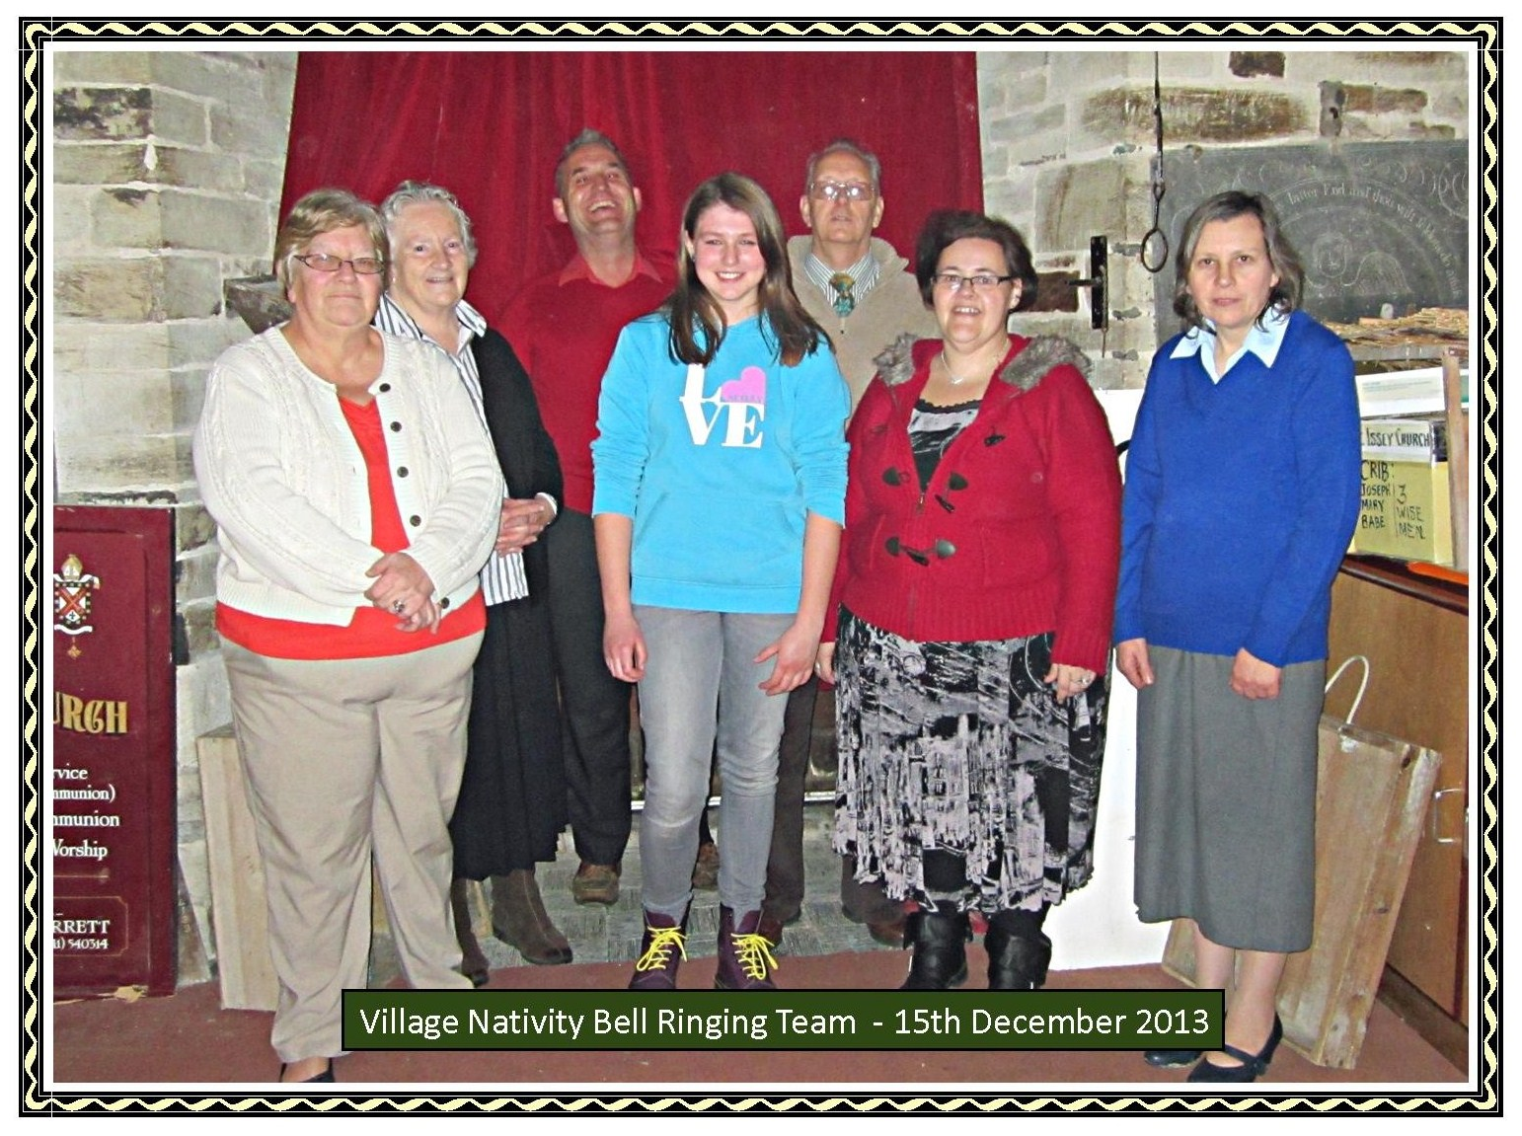

Slide 23
Discussion & Question time!
Revitalising a Band
Brian Wood BA (Hons)

